Slide 1

Hopfield networks and Holograms, Magnets and Memories

Slide 2
Hopfield network
Hebbian Learning having Associative memory with characteristics
Binary Model
Update Equations
Convergence & Error function
Hebbian Learning / Outer product rule
Concepts:
Attractor as a memory
Emergent behavior – order in randomness

Slide 3
Applications:
Associative memory/Content Addressable Memory (CAM)
Capacity results
Role of p/N ratio
Spurious memories
Difficulties:
Low capacity
Spurious minima

Slide 4
Extensions:
Continuous model
Hardware realization
Cohen-Grossberg model
Bidirectional Associative Memory

Slide 5
Introduction
Reentrant connections are more common in Brain than cascades of neural layers connected in feedforward fashion. eg: A cortical area can project in a series of subcortical nuclei, ultimately receives feedback from a nucleus at the end of a long chain, forming a loop.
Hopfield network is a simple neural network model that has feedback connections. Its significance lies in the fact that it was able to bring together ideas from neurobiology and psychology and present a model of human memory, known as an associative memory.
The concept of an associate memory can be best explained by contrasting it with computer memory, which is known as indexed memory.

Slide 6
Feedforward Neural Network
Recurrent Neural Network

Slide 7
Indexed memory consists of two columns of data. The first column refers to addresses and the second to contents.
It is not possible to fetch the address with the help of the content or sub-content2 with the help of subcontent1
in an associative memory, A given item can act as an “address” or “content” depending on the context.
It is possible to have non-neural network-based based associative memories.
See Kanerva’s memories for example.
Indexed memory:
Name ₁ | Name ₂ | Name ₃
Address₁, Telephone₁ | Address₂, Telephone₂ | Address₃, Telephone₃
Associative memory:
Names
Telephone nos
Address

Slide 8


Slide 9


Slide 10


Slide 11
Autoassociative Memory
X
DNN
Y
Autoassociative
Memory
X
X’
Also called Content Addressable Memory

Slide 12
Autoassociative Memory
Hopfield
Network
X(0)
X(T)
Incomplete Pattern
Complete Pattern

Slide 13

Memories are holograms
Karl Pribram one of Lashley’s students continued the search for the engrams, a lifelong pursuit of his teacher, and…
…saw the analogy between
Memories and Holograms
Karl Pribram (1919-2015)

Slide 14
Holograms
Holograms are 3D-like displays of objects
Unlike images which look the same as view varies…
A hologram varies with varying view
They are based on the principle of Interference of Light

Slide 15
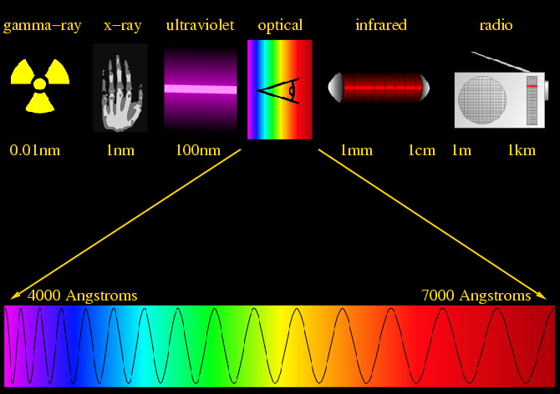
Light is a wave

Slide 16

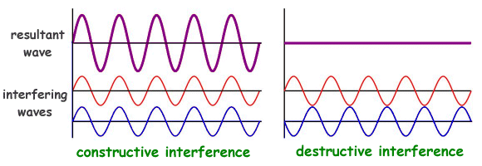
Waves and Interference

Slide 17
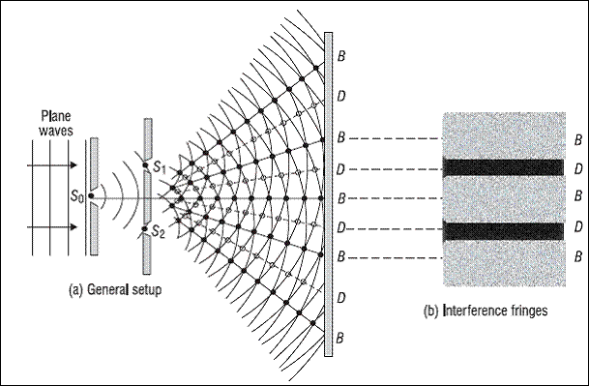
Interference patterns of Light
Constructive interference
Destructive interference

Slide 18
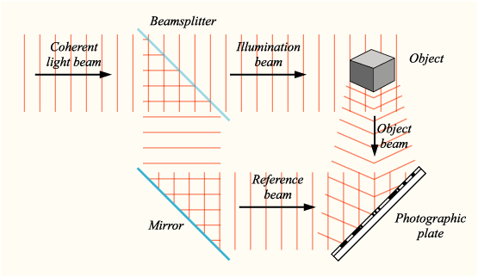
Hologram Recording
Wiki

Slide 19
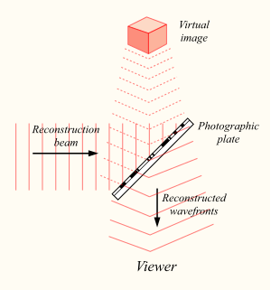
Hologram Reconstruction
Wiki

Slide 20
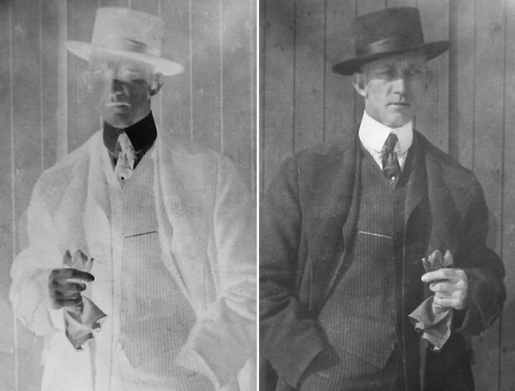
Photograph vs…

Slide 21


Hologram
Reconstructed from the original
Hologram
Reconstructed from a partly (locally)
destroyed Hologram

Slide 22
A synthesis of many ideas

Slide 23
Discrete Hopfield Network
Hopfield has proposed two basic models of associative memories (Hopfield 1982, 1984).
In the discrete Hopfield network, each neuron has a binary state
The state of the network with N neurons is represented by the vector,
The network is fully-connected, i.e., each neuron connected to all others.
The weight from j’th neuron to i’th neuron is given by, and weight matrix is given as
Since the network has loops, computations are dynamic and the network state evolves through time, which is a discrete variable.

Slide 25
Update
At any time step, t, each neuron receives inputs form all other neurons, and updates its own state. The next state of i’th neuron is expressed as a function of current state of the network as follows:
Update Equations:
Where s() is the sign function, sign().

Slide 27
Convergence and Energy function
Energy function:
E is bounded since V is bounded.
Assume we are updating Vi, calculate the change in E. Consider only the terms in E
which contains Vi.
If delta(Vi) < 0, (1 → -1): the sum is also –ve.
If delta(Vi) > 0, (-1 → 1): the sum is also +ve.
Therefore, delta(E) is always –ve or 0.
But since E is bounded the updating process for ‘E’ should eventually converge.

Slide 30
Hebb’s rule
Suppose we want to store S = {Si} in a network. For that E should be minimum at S. So we chose, E is minimum at S = V.
Putting E in the standard form given above:
So the weight matrix required to store a pattern S is:
W_{ij} = 1/N (S_{i} S_{j}).
To store multiple patterns, S^{p} the rule is:

Slide 31
Hebb’s rule
Single Element form:
Single pattern storage
Multiple pattern (P) storage
Matrix form:
Single pattern storage
Multiple pattern storage

Slide 32
MLP vs Hopfield network
 | MLP | Hopfield
State Update | Instantaneous | Iterative
Weight Update | Iterative | Instantaneous

Slide 33
State update
(Online update)
(Batch update)

Slide 34
When only a single pattern, S, is stored,
S is a stationary state.
Consider, V(0) = S,
Therefore, V = S is stationary.

Slide 35
Hopfield Networks and Spin Glass Systems
A magnetic material consists of a set of atomic magnets arranged on a crystal lattice.
Each atomic magnetic has a spin associated with it. Spin = +/-1
Spin of an atomic magnet is influenced by the magnetic field, h, at its location.
Field = external field (h_{ext}) + internal field (produced by other spins)

Slide 36
Analogy with Magnetic Materials
Spin ➔ Neuron’s Binary State
The spin of a given particle is influenced
by the spins of the neighboring
particles.
“Energy function” ➔ Hamiltonian
Minimum Energy States ➔ memories

Slide 37
W_{ij} = (exchange interaction strength) measure of strength of interaction of influence of spin Sj on the field at Si.
Interactions are symmetric. Wij = Wji.
Potential energy corresponding to the interaction is:

Slide 38
Magnetic Memory
Distinct stable domains:
all spins in a given domain are pointed in the same direction

Slide 39
Hebbian Learning
“When an axon of a cell A is near enough to excite a cell B and repeatedly or persistently takes part in firing it, some growth process or metabolic change takes place in one or both cells such that A’s efficiency, as one of the cells firing B, is increased.” (‘Organization of Behavior’ by Donald Hebb)
When two neurons are simultaneously active, the connection between them must be strengthened; when one of them is active, while the other is inactive, the connection strength must be weakened.
“Neurons that fire together, wire together.”

Slide 40
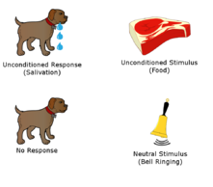
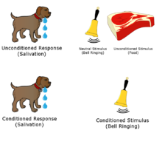
Pavlovian Conditioning or Classical Conditioning
https://en.wikipedia.org/wiki/Classical_conditioning
Pavlov was awarded the Nobel Prize in 1904 for Physiology and Medicine

Slide 42
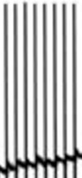
Long-term Potentiation (LTP)
Depolarising current
Presynaptic
terminal
Postsynaptic
terminal
Presynaptic | Postsynaptic | Outcome
High Frequency APs | Depolarization | Synaptic strengthening (LTP)

Slide 43
Long-term Depression (LTD)
Hyperpolarising current
Presynaptic
terminal
Postsynaptic
terminal
Presynaptic | Postsynaptic | Outcome
High Frequency APs | Hyperpolarization | Synaptic weakening (LTD)

Slide 44
Storing Multiple Patterns

Slide 45
The problem of Spurious states
A problem arises when we try to store multiple patterns using Hebb’s rule.
In addition to the stored states, certain other states known as spurious states, also end up becoming stable, interfering with the network operation.
Therefore, when the network is prompted with the corrupt version of a stored pattern, the network might retrieve a pattern which is not one of the stored patterns, thereby diminishing the network’s retrieval performance

Slide 46
Types of Spurious states
Mirror states: It can be shown that if S is a stable state, -S is also a stable state.
Proof: If S is stable, we know that
S = g(WS)
If g is the sign() function, we have –x = g(-x), if x = +1. Therefore, we have,
-S = g(-WS).

Slide 47
Mixture states: S^{mix} = sign(+S1 + S2 + S3)
Proof: S^{mix} and S^{p} (p = 1,2,3) have the same sign on an average 3 times out of 4.
Hence,
Therefore,
If the cross-terms can be ignored, the mixture state is stable.

Slide 48
Spin glass states: Stable states that are not correlated with the stored patterns.

Slide 49
If N is large, from Central Limit Theorem we know that C_{i} has a Gaussian distribution with the above mean and variance.

Slide 50
Memory Capacity
Rapid degradation of retrieval performance beyond,
P/N = 0.138
Hopfield got P/N = 0.15 through experiments.

Slide 51
Improving Capacity:
The self-weights must be set to zero for improved retrieval performance.
Wii = 0
To understand this, consider, wii >> 1,
V_{i}(t+1) \approx g(w_{ii} V_{i}(t)) = V_{i}(t). That is every state is stable. Therefore, there is a greater chance of obtaining spurious states.

Slide 52
Numerical Example

Slide 54
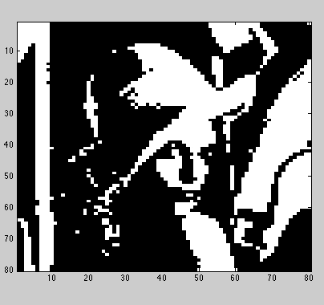

Slide 55
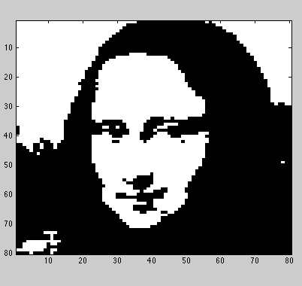

Slide 56
Continuous Hopfield Network

Slide 57
V(t+1) ← V(t) - discrete model
dV/dt = f(V) - continuous model
Equations:

Slide 59
Lyapunov or “Energy” Function:
Proof:
Therefore, E decreases monotonically with time.

Slide 60
Single neuron: Condition for stability
Dynamics of a single neuron in the continuous Hopfield network may be given as:
assuming that the external input I_{i} is zero.
At convergence we have,
du/dt = 0, or
u = w tanh(lu).

Slide 61
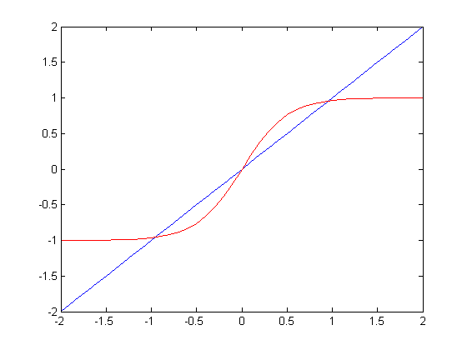
Solution to the last equation may be represented as intersection of two plots,
y= u (1)
y= w tanh(λu) (2)
which is graphically represented.
V+
V0
V-

Slide 62
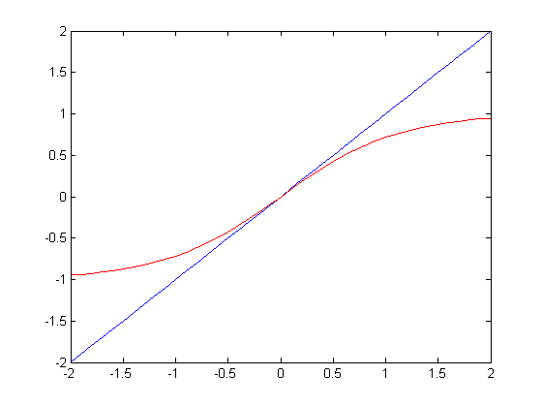
The number of intersection points obtained depends on the value of lam.
For λ > 1, we have three intersection points, and for λ < 0, we have only one intersection point at the origin
V0

Slide 63
For λ > 1: Let us call the three intersection points V+, V-, V0 (origin), which are also the stationary points of eqn.
A stationary point is stable, if
The two terms on the right side are the slopes of the eqns. (1, 2) respectively.

Slide 64
Therefore, when the slope of the sigmoid, which is true for both V+, V_ but not true at the origin.
Therefore, V+ and V_ are stable but the origin is unstable.

Slide 65
For λ < 1:
In this case, there is only one intersection point at the origin.
Since the slope of the sigmoid is less than 1 at the origin, the origin is stable.

Slide 66
A two-neuron system
Let us consider a simple two-neuron system with weight matrix W = [1 -1 ; -1 1].
λ= 2.

Slide 67
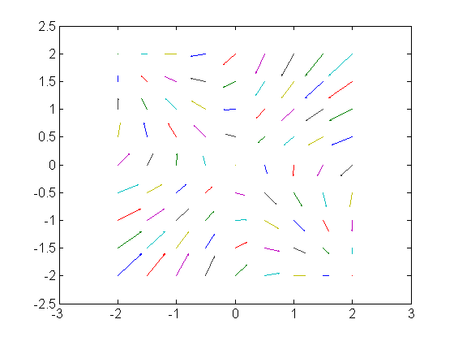
The figure depicts the vector field defined by the above system.
There are stable nodes at (-2,2) and (2, -2) and the origin is a saddle node.

Slide 68
Problem
In the original Hopfield model,
Neural activity evolves through time
Weights are calculated in one-shot
It would be biologically more plausible if weights can be trained over time

Slide 69
The Adaptive Hebbian Learning in Hopfield Network

Slide 70
In both discrete and continuous Hopfield network weights trained in a one-shot fashion and not trained incrementally as was done in case of Perceptron and MLP. There is a variation of Hopfield network in which weights are adjusted incrementally. Dynamics of the Hopfield network with adaptive weights is described below.
(Activation dynamics) (1)
(Weight dynamics) (2)
Where (τ_{a} << τ_{w}) and

Slide 71
The combined system has an expanded “energy” function given as,
(3)
Note that when the weights stabilize,
or (4)
Which is similar to the Hebb’s rule of the earlier Hopfield models.
But the rule would amount to storing the network state in the weights,

Slide 72
The external input imposes itself on the network state V, which in turn can be written onto the network weights w.
I → V → w
To ensure such a steady transfer of information from the external input to the network weights, we need certain additional mechanisms. To this end, we add a few coefficients (A, B and C) to the above eqns. as follows
Activation dynamics: (5)
Weight dynamics: (6)

Slide 75
We divide the operation of the network into separate
1) storage and
2) retrieval stages.

Slide 76
Storage dynamics
During storage the pattern to be stored is presented as external input I. The network state, V, must copy I. The network state V is then written onto the weights by eqn. (6).
For this to be possible, in eqn. (5), 'A' must be a large positive number. Similarly 'B' must be a small positive number so that it does not allow the preexisting weights to influence the current state of the network.
During storage, obviously the weights have to be adapted. Therefore, 'C' must be a finite positive number.

Slide 77
Retrieval dynamics
Retrieval dynamics must be obviously dominated by the preexisting weights;
Therefore B should be large positive number.
The external input should only be suggestive of the pattern that needs to be retrieved, and therefore need not be very large. Therefore 'A' must be a small number.
During retrieval the weights are in principle not adjusted; therefore 'C' is zero.

Slide 78
Summary
The Continuous Hopfield network with adaptive weights must have its coefficients A, B, C to be set as follows:
Storage stage: high A, low B, and high C.
Retrieval stage: low A, high B and zero C.
We will now see that mechanism of the type described above can be seen in Hippocampus, a part of the brain involved in memory.

Slide 79
Hippocampus – memory storage and recall

Slide 80
We have seen in Chapter 2 that hippocampus (HC) is a “scratch pad” of memories.
Damage to HC is known to impair our ability to store and retrieve memories.
Earliest knowledge about the memory-related functions of HC came out of studies of a patient known as Henry Molaison, usually referred to as HM.

Slide 81
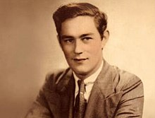
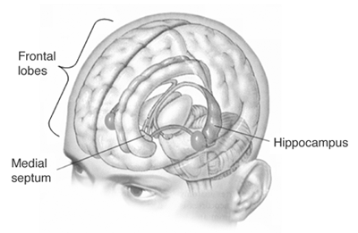
HM
Both hippocampi removed
To treat epilepsy

Slide 82
HM had his medial temporal lobe removed as a treatment to his epileptic attacks, with which he was suffering since his childhood.
Loss of HC which is located in the temporal lobe, cause memory impairment or amnesia. He suffered from two kinds of amnesias.

Slide 83
Amnesias
Retrograde amnesia: inability to recall old memories.
Had poor memory of events that happened immediately before his surgery, but older memories were intact.
Anterograde amnesia: inability to store new memories.

Slide 84
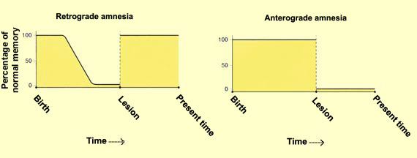
https://thebrain.mcgill.ca/flash/i/i_07/i_07_p/i_07_p_oub/i_07_p_oub.html

Slide 85
Hebbian Learning and Long-term Potentiation (LTP) in hippocampus
We have seen that synaptic modification is the key substrate to learning and memory phenomena in the brain.
Particularly we have seen how Hebbian learning can enable storage of information as attractors in network dynamics.
Although when Hebbian learning was proposed in late ‘40s, it was only a hypothesis, experimental evidence for the same was first discovered in the synapses of HC in the ’60s.

Slide 87
These studies have essentially shown that when both pre- and post-synaptic ends are simultaneously stimulated, the synapse gets strengthened or potentiated.
This phenomenon is known as Long term Potentiation (LTP).
When only one side is stimulated, the synapse gets weakened or depressed, a phenomenon known as Long-term Depression (LTD).

Slide 88
In studies of this kind, typically, the presynaptic terminal is stimulated by a high-frequency volley of impulses, which amounts activation of the presynaptic side.
On the post-synaptic side the membrane is depolarized by injecting a positive current. Initial strength of the synapse is assessed by stimulating the presyanptic side with a low frequency volley of impulses, and amplitude of the resulting PSP is noted.

Slide 89
After stimulating the pre- and post-synaptic sides simultaneously, as described above, for about 10-15 mins, the synaptic strength is again assessed by stimulating the pre-synaptic side with a low frequency volley.
It is seen that the PSP now is greater than the PSP observed before stimulation

Slide 90
LTP, which is a biological substrate of Hebbian learning, has been found to occur in many hippocampal synapses.
But for pattern storage we require Hebbian learning occurring in a network with strong recurrent connections.
Does HC have strongly recurrent connectivity?
To answer this question, let us consider the anatomical connectivity patterns within the HC and also its connections to other parts of the brain, particularly the cortex.

Slide 91
What is the connection between the Hopfield network and Hippocampus?

Slide 92
Cortex and the Hippocampus connections:
HC is basically a system for association. It captures relationships among representations of the same object present in different sensory modalities.
For example, when you holding a cup in your hand, your visual system processes the appearance of the cup, - its size, color, distance from your eyes etc.
Your somatosensory system processes the feel of the cup, its hardness or softness, its temperature etc.

Slide 93
Both these streams of sensory information contain information about the cup. This high level information about the cup is extracted at higher stages of sensory cortices and forwarded to HC.
Thus HC receives compact high-level representations of the object. HC also receives reward related information from prefrontal cortex and subcortical structures like amygdala.
HC combines the compact representation of the object, and the relevant reward information and decides if the information is worth storing for longer-term back in the cortex, or must be discarded.

Slide 94
HC receives inputs from large parts of the neocortex which project to parahippocampal gyrus and perirhinal cortex.
The last two areas project to Entorhinal cortex which is considered the gateway to HC.

Slide 96
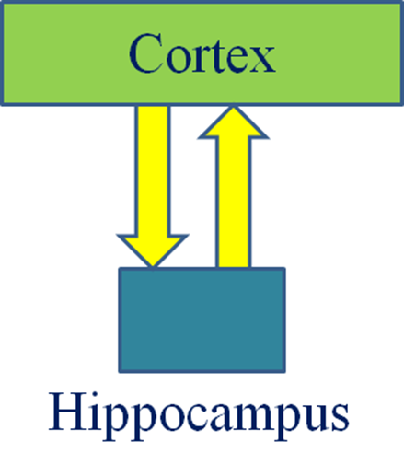

Slide 97
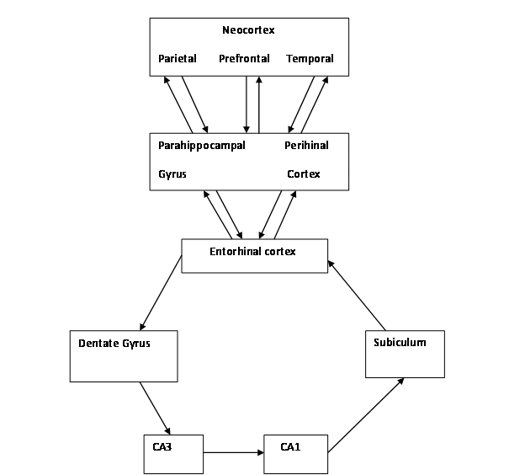

Slide 98
Bidirectional Associative Memory

Slide 99
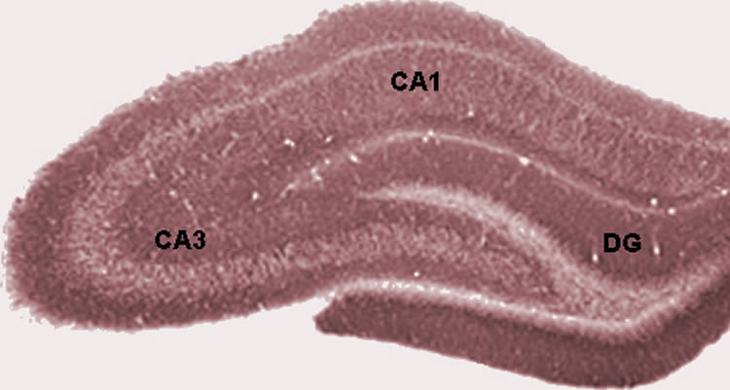
Hippocampal slice

Slide 100
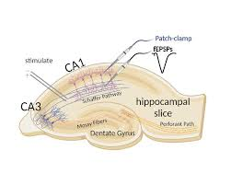
Hippocampal slice

Slide 101
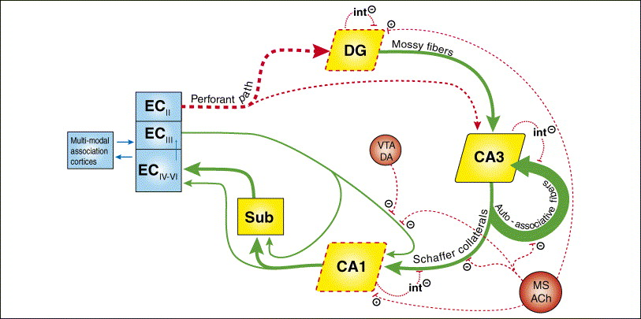
https://www.memorangapp.com/flashcards/127486/Limbic+System/

Slide 102
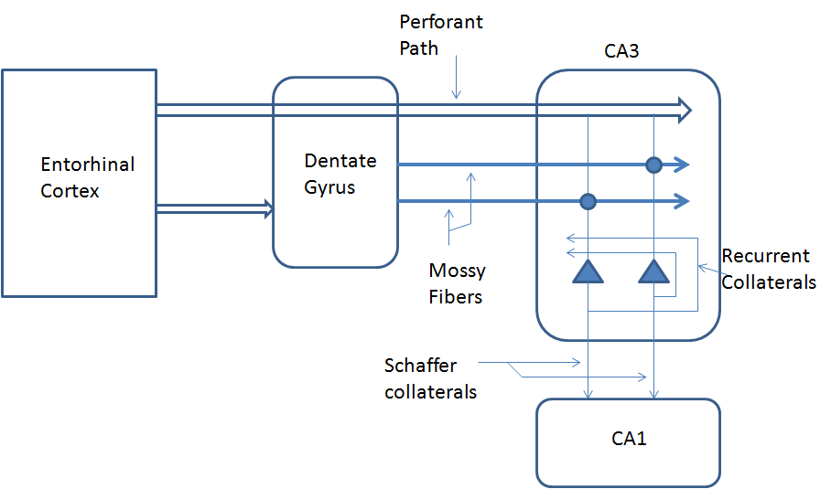

Slide 103
Parallel pathways within HC
One branch of EC output into the HC goes to Dentate Gyrus, which in turn projects to CA3 via fibers known as mossy fibers.
EC also projects directly to Dentate gyrus via the perforant pathway.
The mossy fibers are known to have strong synapses, while the perforant pathway has a weaker influence on CA3.

Slide 104
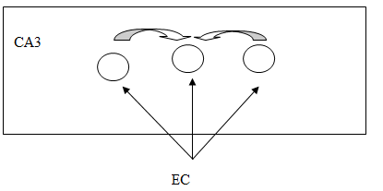
Is CA3 a Hopfield Network?
There is a theory that CA3 could be operating like a Hopfield network

Slide 105
Recurrent connections in CA3
CA3 neurons have extensive recurrent connections.
In rat there are about 300,000 pyramidal neurons in CA3, with each of them receiving inputs from about 12,000 other CA3 pyramidal neurons. In contrast, each CA3 pyramidal neuron receives only 4000 inputs from EC.

Slide 106
Each CA3 neuron receives inputs from about 4% of all CA3 pyramidals,
high recurrence - high compared any other brain region.
These recurrent connections are modifiable by LTP.
A strong possibility of CA3 acting as some sort of a Hopfield network in which patterns are stored as attractors.

Slide 107
Storage and Retrieval in CA3:
We have considered evidence that CA3 has features of an autoassociative network –
high recurrence and plastic synapses.
But for the network to be useful as a memory, it must be operable in two modes –
Storage
Retrieval
Special conditions are required

Slide 108

The Classroom Analogy (“STORAGE”)
Teacher’s instruction
dominates
Chatter among the
children is low
Children are in a state
of receptivity, eager to
LEARN the lesson
“Learning the Lesson”
Stage

Slide 109
The Classroom Analogy (“RETRIEVAL”)
Teacher’s instruction
is LOW
Conversations among
the children are HIGH
Children DO NOT LEARN
anything new;
they only discuss
among themselves
and reproduce
what they know
“Discussing and Reproducing
the Lesson”
Stage

Slide 110
Conditions for Storage
During storage:
External input is STRONG
Recurrent connections are WEAK
Recurrent connections are PLASTIC
External
Input from EC
CA3

Slide 111
Conditions for Retrieval
During storage:
External input is WEAK
Recurrent connections are STRONG
Recurrent connections are NOT PLASTIC
External
Input from EC
CA3

Slide 112
CA3 has two external inputs:
from EC by perforant pathway, and the other
from EC via Dentate Gyrus by mossy fibers.
Perforant pathway inputs are weaker than mossy fibers.
Plasticity of CA3 recurrent connections:
Acetylcholine (Ach) is a neuromodulator that is capable of controlling the strength and plasticity of recurrent connections in CA3.

Slide 113
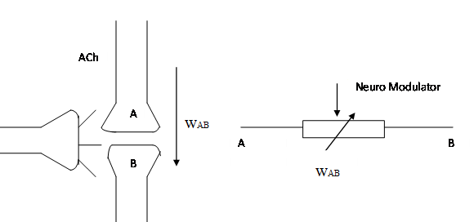
Neuromodulator
Neuromodulator controls plasticity
It can rapidly change the synaptic strength

Slide 114
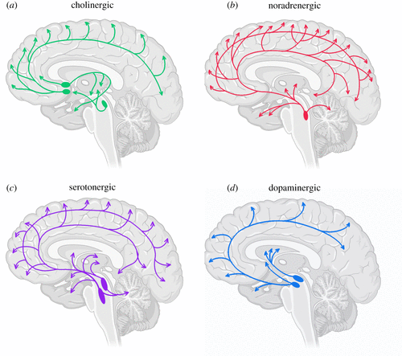
Nucleus Basalis
Locus Ceruleus
Acetylcholine
Norepinephrine
Raphe Nucleus
Ventral Tegmental Area
Serotonin
Dopamine

Slide 115
Acetylcholine (ACh) as a Neuromodulator
Some common neuromodulators in the brain are:
Acetylcholine, dopamine, norepinephrine and serotonin
Blockage of ACh transmission in HC is known to interfere with memory storage.
Scopolamine (ACh antagonist) → temporary amnesia

Slide 116
Scopolamine in a memory task
Volunteers were given a dose of scopolamine and were asked to memorize words.
They had little or no memory of the information presented during the test
Some volunteers even forgot about the trial.
Scopolamine before experiment:
Controls = 45 out of 128 words
Scopolamine subjects = 6 out of 128 words

Slide 117
When subjects were given scopolamine after the words were presented, no impairment in performance.
Specifically, there is also evidence that Ach controls LTP in the recurrent connections of CA3.
Michael Hasselmo and coworkers have suggested that Ach satisfies the criteria necessary to switch between storage and retrieval as follows:

Slide 118
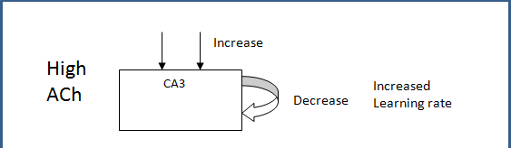
At high levels of ACh,
Input is strengthened
Recurrent connections of CA3 are weakened
Increased plasticity in recurrent connections of CA3

Slide 119
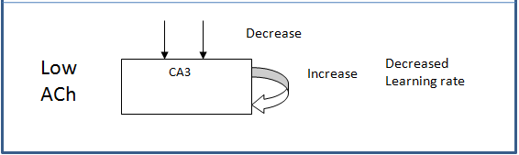
At low levels of ACh,
Input is weakened
Recurrent connections of CA3 are strengthened
Decreased plasticity in recurrent connections of CA3

Slide 120
Differential action of ACh in CA3
Ach has different actions on different parts of CA3.
Inputs to CA3 pyramidal neurons from different sources are anatomically segregated in CA3.
Inputs from EC to CA3 pyramidal neurons are located in a CA3 layer known as stratum lacunosum-moleculare.
Recurrent inputs from other CA3 pyramidal neurons are located in a CA3 layer known as stratum radiatum.

Slide 121
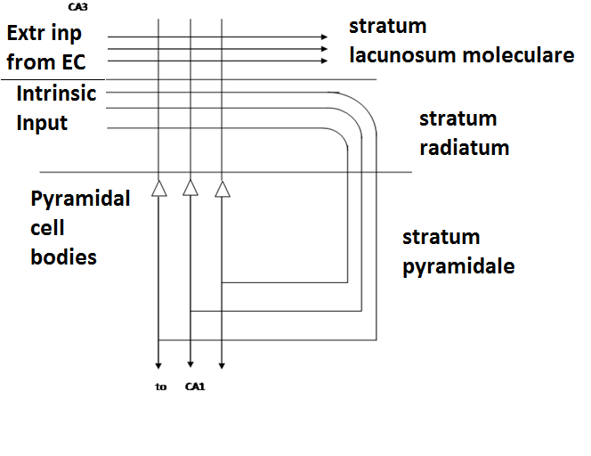
CA3 connectivity

Slide 122
Action of ACh on CA3
High Ach:
it suppresses the synapses in stratum radiatum much more than it does to synapses in stratum lacunosum-moleculare.
High ACh suppresses recurrent connections more than inputs coming from EC.
High Ach also increases LTP in CA3 recurrent connections.

Slide 123
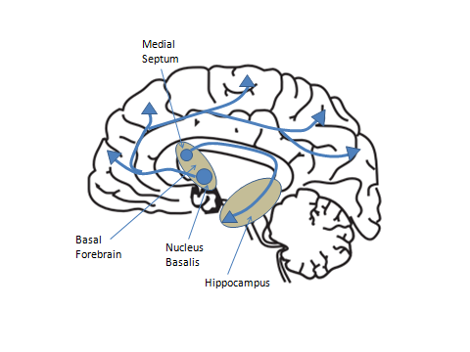
What modulates the modulator?
What controls ACh release to HC?
ACh is released by two neuronal clusters located in the basal forebrain.
Nucleus Basalis: projects to widespread cortical targets.
Medial septum: projects to HC.

Slide 124
The Septohippocampal loop
When this branch is stimulated it decreases the neural activity in medial septum.
Thus, the loop from medial septum to HC and backwards acts as a self-regulating system for HC.
Particularly it is known that the feedback exists from CA1 field of HC.

Slide 125
Septohippocampal Loop
-
CA1
Medial
Septum
CA3
Hasselmo and colleagues proposed that the above loop is capable of making sure that ACh is released just when it is required.

Slide 126
CA3
-
Reconstructed
Pattern
Entorhinal
Cortex
CA1
+
Original
Pattern
If the Original and Reconstruction match,
Do NOT activate Medial Septum → no Ach release
If the Original and Reconstruction do not match,
Activate Medial Septum → Ach release → Store pattern in CA3

Slide 128
Summary
Hippocampus as a short term memory store
CA3 as some sort of a Hopfield network
The two modes of operation: storage and retrieval
The role of Ach as a neuromodulator
The role of the septohippocampal network
Does not address:
The issue of saliency as a criterion for storage
The transfer from short term to long term storage

Slide 129
Reference
Gateway to Memory by Gluck and Meyers, MIT Press.
Demystifying the Brain by VSC, Springer.

Slide 130
The last two areas project to Entorhinal cortex which is considered the gateway to HC.
Information from EC propagates in that sequence via Dentate Gyrus, CA3, CA1 and subiculum before returning to EC. EC projects back to the neocortical targets via parahippocampal gyrus and perirhinal cortex.
Thus HC receives compressed representation of information arising out of many sensory modalities, and applying the criteria of saliency which depends on the associated reward, sends the information back to the neocortex for long-term storage.

Slide 131
The flow of information within the HC described above is rather simplistic.
While it is true that information arising out of EC circulates through the HC and returns to EC, the path it follows is not a simple, singular loop as described above.
Information from EC flows through multiple parallel pathways before returning to EC

Slide 132
One branch of EC output into the HC goes to Dentate Gyrus, which in turn projects to CA3 via fibers known as mossy fibers.
EC also projects directly to Dentate gyrus via the perforant pathway.
The mossy fibers are known to have strong synapses, while the perforant pathway has a weaker influence on CA3.

Slide 133
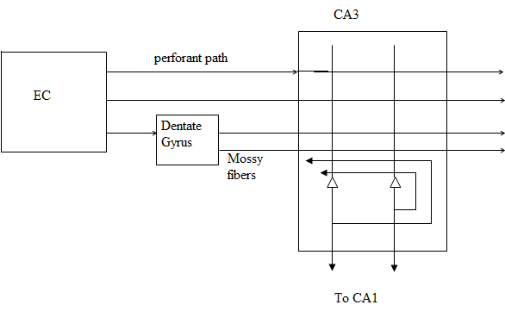
This difference in the relative strengths of the two afferents to CA3 seems to be significant, as we shall see shortly, to memory storage and recall operations of HC. CA3 neurons have extensive recurrent connections among themselves

Slide 134
As mentioned above, CA3 neurons have extensive recurrent connections.
In rat there are about 300,000 pyramidal neurons in CA3, with each of them receiving inputs from about 12,000 other CA3 pyramidal neurons. In contrast, each CA3 pyramidal neuron receives only 4000 inputs from EC.

Slide 135
Effectively, each CA3 neuron receives inputs form about 4% of all CA3 pyramidal cells, a level of recurrence that is high compared any other brain region.
Furthermore, these recurrent connections are modifiable by LTP.
Therefore, though the level of recurrency in CA3 is much lesser than that in the Hopfield network, it suggests the strong possibility of CA3 acting as some sort of a Hopfield network in which patterns are stored as attractors.

Slide 136
We have seen that the memory capacity, P, of a fully-connected Hopfield network, in which the binary state (1/0) of each neuron is 1 or 0 with equal probability, equals 0.14 N, where N is the number of neurons in the network.
But it has been found that capacity is greater when sparseness conditions are imposed on the stored patterns.

Slide 137
A pattern is considered to be sparse when instead of half the neurons being active (+1), only a small fraction, a, of neurons are active. There is evidence that only a small fraction of CA3 neurons are active at any given instant (evidence regarding this matter is reviewed in (Treves and Rolls, 1994)).

Slide 138
Storage capacity of CA3 system in rat, which depends on sparseness, a, is estimated by Treves and Rolls (1994). Sparseness is defined as:

Slide 139
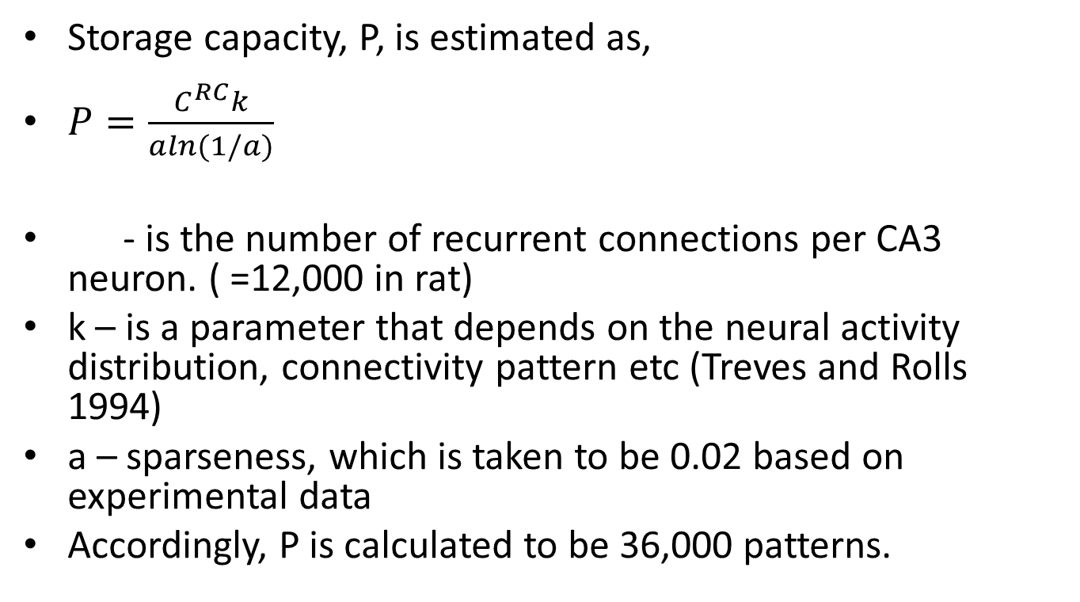
Storage capacity, P, is estimated as,
$P=\frac{C^{RC}k}{aln(1/a)}$
- is the number of recurrent connections per CA3 neuron. ( =12,000 in rat)
k – is a parameter that depends on the neural activity distribution, connectivity pattern etc (Treves and Rolls 1994)
a – sparseness, which is taken to be 0.02 based on experimental data
Accordingly, P is calculated to be 36,000 patterns.

Slide 140
Storage and Retrieval in CA3:
We have considered evidence that CA3 has features of an autoassociative network – high recurrence, sparseness and plastic synapses.
But these features in themselves are not sufficient, since for the network to be useful as a memory, it must be operable in two modes – storage and retrieval.
Very different conditions must prevail in the network when it operates in these two modes.

Slide 141
Recall the two modes of operation of the Cohen-Grossberg model during storage and retrieval.
During storage:
External input is strong
Recurrent connections are weak
Recurrent connections are plastic
During retrieval:
External input is weak
Recurrent connections are strong
Recurrent connections are not plastic

Slide 142
Let us consider if the above features are available in and around CA3.
CA3 has two external inputs: one from EC by perforant pathway, and the other from EC via Dentate Gyrus by mossy fibers. There is evidence that perforant pathway inputs are weaker than mossy fibers.
Strength and plasticity of CA3 recurrent connections: Acetylcholine (Ach) is a neuromodulator that is capable of controlling the strength and plasticity of recurrent connections in CA3.

Slide 144
A neuromodulator alters the strength of a synapse. Some common neuromodulators in the brain are:
Acetylcholine, dopamine, norepinephrine and serotonin
Blockage of ACh transmission in HC is known to interfere with memory storage.
Scopolamine (Ach antagonist) → temporary amnesia

Slide 145
Volunteers were given a dose of scopolamine and were asked to memorize some information.
They had little or no memory of the information presented during the test
Some volunteers even forgot about the trial.
Scopolamine before experiment:
Controls = 45 out of 128 words
Scopolamine subjects = 6 out of 128 words

Slide 146
When subjects were given scopolamine after the words were presented, no impairment in performance.
Specifically, there is also evidence that Ach controls LTP in the recurrent connections of CA3.
Michael Hasselmo and coworkers have suggested that Ach satisfies the criteria necessary to switch between storage and retrieval as follows:

Slide 147
At high levels of Ach,
Input is strengthened
Recurrent connections of CA3 are weakened
Increased plasticity in recurrent connections of CA3
At low levels of Ach,
Input is weakened
Recurrent connections of CA3 are strengthened
Decreased plasticity in recurrent connections of CA3

Slide 148
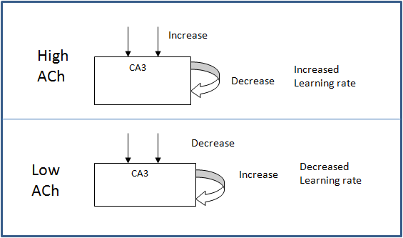

Slide 149
Such complex differential action of Ach is possible because, Ach has different actions on different parts of the neuron.
Furthermore, inputs to CA3 pyramidal neurons from different sources are anatomically segregated in CA3.
Inputs from EC to CA3 pyramidal neurons are located in a CA3 layer known as stratum lacunosum-moleculare.
Recurrent inputs from other CA3 pyramidal neurons are located in a CA3 layer known as stratum radiatum.

Slide 150
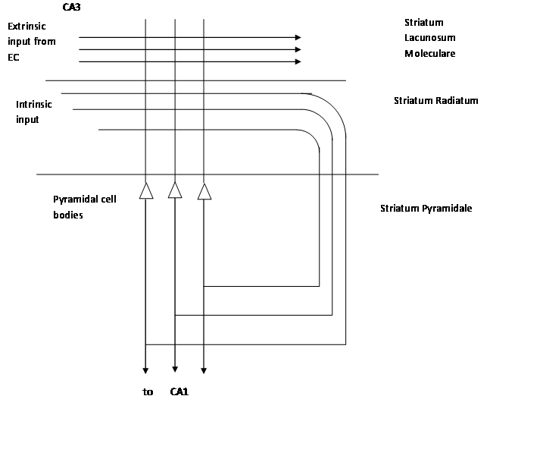

Slide 151
When ACh or an agonist of ACh is applied to CA3, it suppresses the synapses in stratum radiatum much more than it does to synapses in stratum lacunosum-moleculare.
Thus at higher concentrations ACh suppresses recurrent connections more than inputs coming from EC. At the same time increased ACh increases LTP in CA3 recurrent connections.

Slide 152
What controls ACh release to HC?
ACh is released by two neuronal clusters located in the basal forebrain.
One cluster called the nucleus basalis, projects ACh to widespread cortical targets. The other cluster called medial septum projects to HC.

Slide 153
When this branch is stimulated it decreases the neural activity in medial septum.
Thus, the loop from medial septum to HC and backwards acts as a self-regulating system for HC.
Particularly it is known that the feedback exists from CA1 field of HC.

Slide 154
Hasselmo and colleagues proposed that the above loop is capable of making sure that ACh is released just when it is required.
Basically ACh must be released when the input to HC, arriving at EC, needs to be stored.
If the input is already stored, ACh release must be blocked.

Slide 155
CA1 receives direct inputs from EC and indirectly via CA3. Hasselmo and coworkers proposed that CA1 acts as a comparator, that compares the original pattern in EC, and its reconstructed version from CA3.

Slide 156
If the two copies are the same, the pattern must have already been stored in CA3. Then CA1 sends a signal to medial septum inhibiting it, and blocking further release of ACh.
If the two copies are not the same, CA1 inhibition of medial septum ceases, thereby causing of release of ACh to CA3, which in turn induces pattern storage.

